Slide 1





  DATA ANALYSIS
  Ammar_Shams
Transforming Data Into Meaningful Business Insights
View CV →

Slide 2









About
Education
Projects
Feedback
Contact
  Aboue Me
Hi! I’m Ammar Shams I’m a Business Information Systems (BIS) student and a Data Analytics trainee at the Digital Egypt Pioneers Initiative (DEPI).
I combine business intelligence with technical data skills to transform raw data into clear, actionable business insights.
Data Analysis
Data Visualization
Business Intelligence
Explor, clean, and analysis datasets to discover meanuingful patterns.
Create clear and interactive dashboards that make insights easy to understand.
Translate data into actionable insights that can support smarter decisions.
Tools & Technologies
Excel
SQL
Power
bI
Python
Tableau

Slide 3






About
Education
Projects
Feedback
Contact
EDUCATION
Learning
  Journey
Building my knowledge through academic
learninf, practical projects, and continuous self-development.
Learn
New Skills
Build
Projects
Gain
Experience
Grow
Continuously
  My Education & Learning path
01
02
03
Academic Education
Technical Learning
Practical Experience
Building a srtong foundation
in my field of study.
Developing my skills in modern
technologies and tools.
Turning knowledge into real projects and applications.
.
.
.
.
.
.
.
Business Information Systems
Programming
Data
AI
Programming
Data
AI

Slide 4


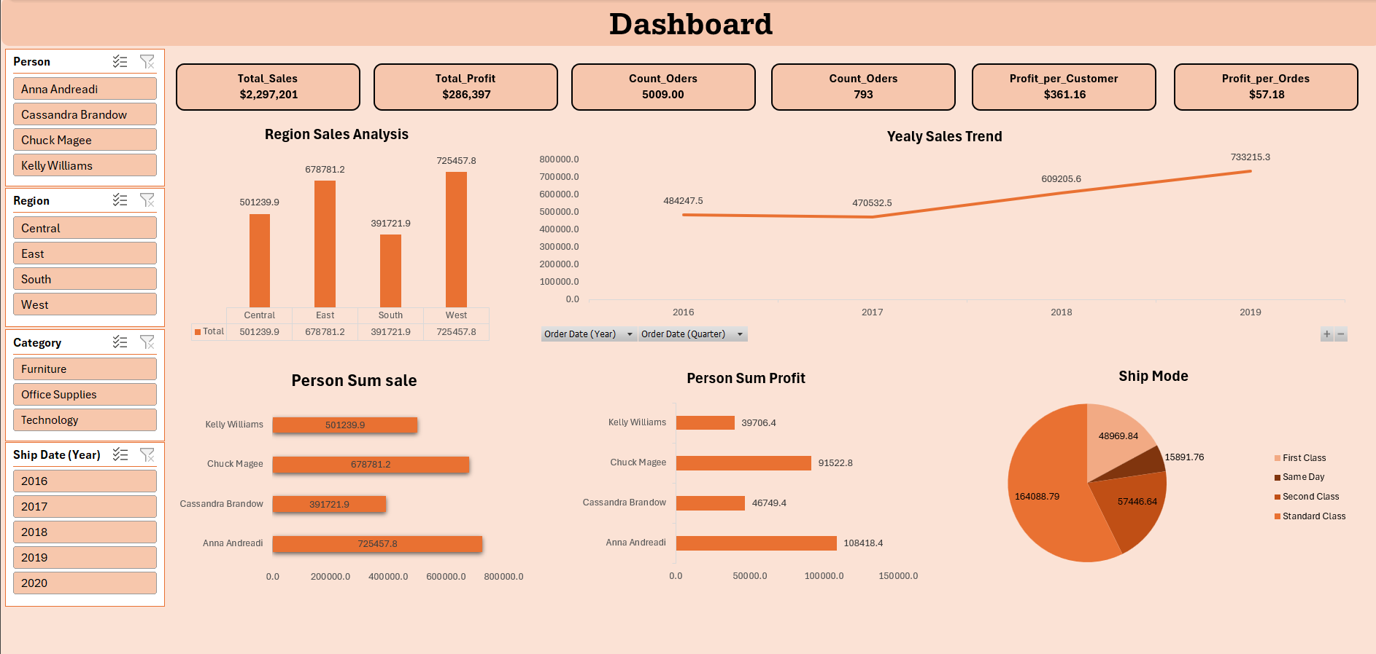
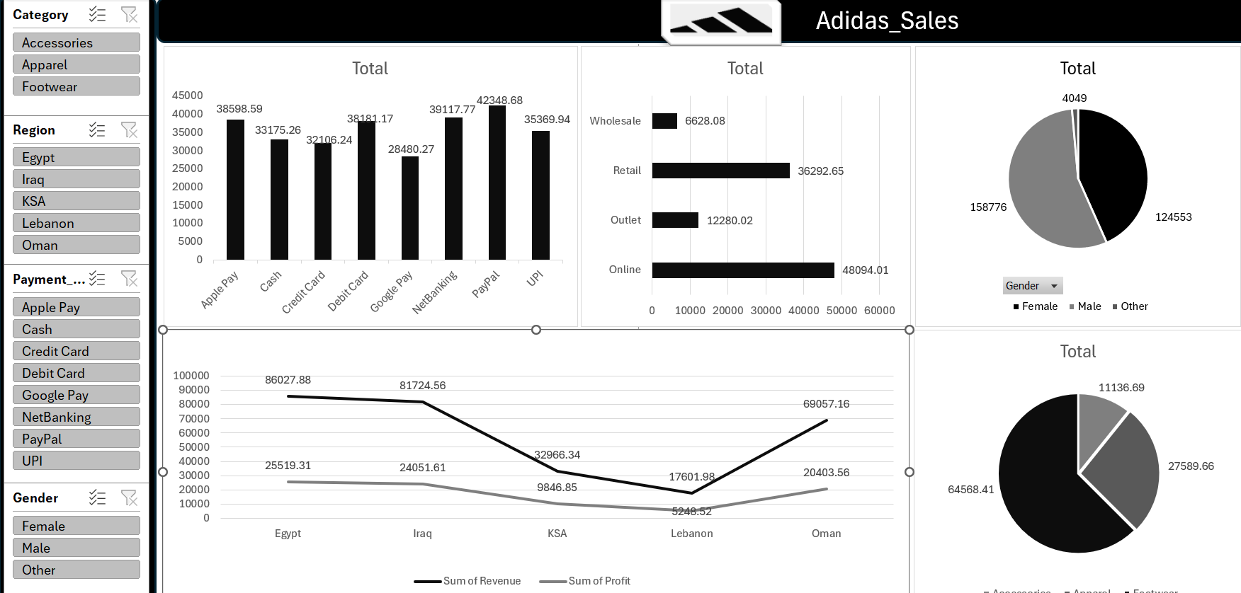
About
Education
Projects
Feedback
Contact
projects
  Turning Ideas Into Real Projects
I build practical applications and experiment with modern technologies to turn ideas into useful solutions.

Slide 5









About
Education
Projects
Feedback
Contact
CLIENT FEEDBACK
What People Say
A few words from people I`ve worked and learned with.
⭐⭐⭐⭐⭐
⭐⭐⭐⭐⭐
⭐⭐⭐⭐
"Exceptional work! He transformed our complex sales data into a clear, interactive Power BI dashboard. It made tracking key performance metrics so much easier and directly helped us boost our sales strategy. Highly professional and punctual!"
"Outstanding technical skills in data cleaning and SQL querying. He handled our large dataset efficiently, identified operational bottlenecks, and provided actionable recommendations that saved us valuable time and resources."
"One of the best data analysts I’ve worked with. He goes beyond just presenting charts—he translates complex data into meaningful business insights that are easy to understand and execute. Highly recommended!"
Ahmed Hassan
Mohsen Mahmoud
Mohamed Ali
E-Commerce Manager
Marketing Specialist
Operations Director

Slide 6



About
Education
Projects
Feedback
Contact
Contact
  Let’s connect
Have a project, idea, or opportunity in mind? I'd love to hear from you.
Email
Linked In
Git Hub
Explor, clean, and analysis datasets to discover meanuingful patterns.
Explor, clean, and analysis datasets to discover meanuingful patterns.
Explor, clean, and analysis datasets to discover meanuingful patterns.
→
→
→

